Slide 1

Online Job Portal: Connecting Talent with Opportunity

Slide 2

The Modern Job Search Landscape
Today's job market presents significant hurdles for both job seekers and employers.
Millions of job seekers struggle to efficiently find relevant job openings that match their skills and aspirations.
Employers often face challenges in quickly identifying and reaching a pool of qualified candidates.
Traditional recruitment methods are frequently time-consuming and can incur substantial costs, hindering efficient talent acquisition.

Slide 3



Understanding the Online Job Portal
An online job portal serves as a dynamic web-based platform designed to bridge the gap between job seekers and potential employers. It acts as a centralized hub, facilitating every step of the recruitment process from initial posting to final communication.
Job Seeker
The Portal
Employer
Actively searches for opportunities, applies, and manages profiles.
Enables job posting, search, application, and communication.
Posts openings, reviews candidates, and initiates contact.

Slide 4
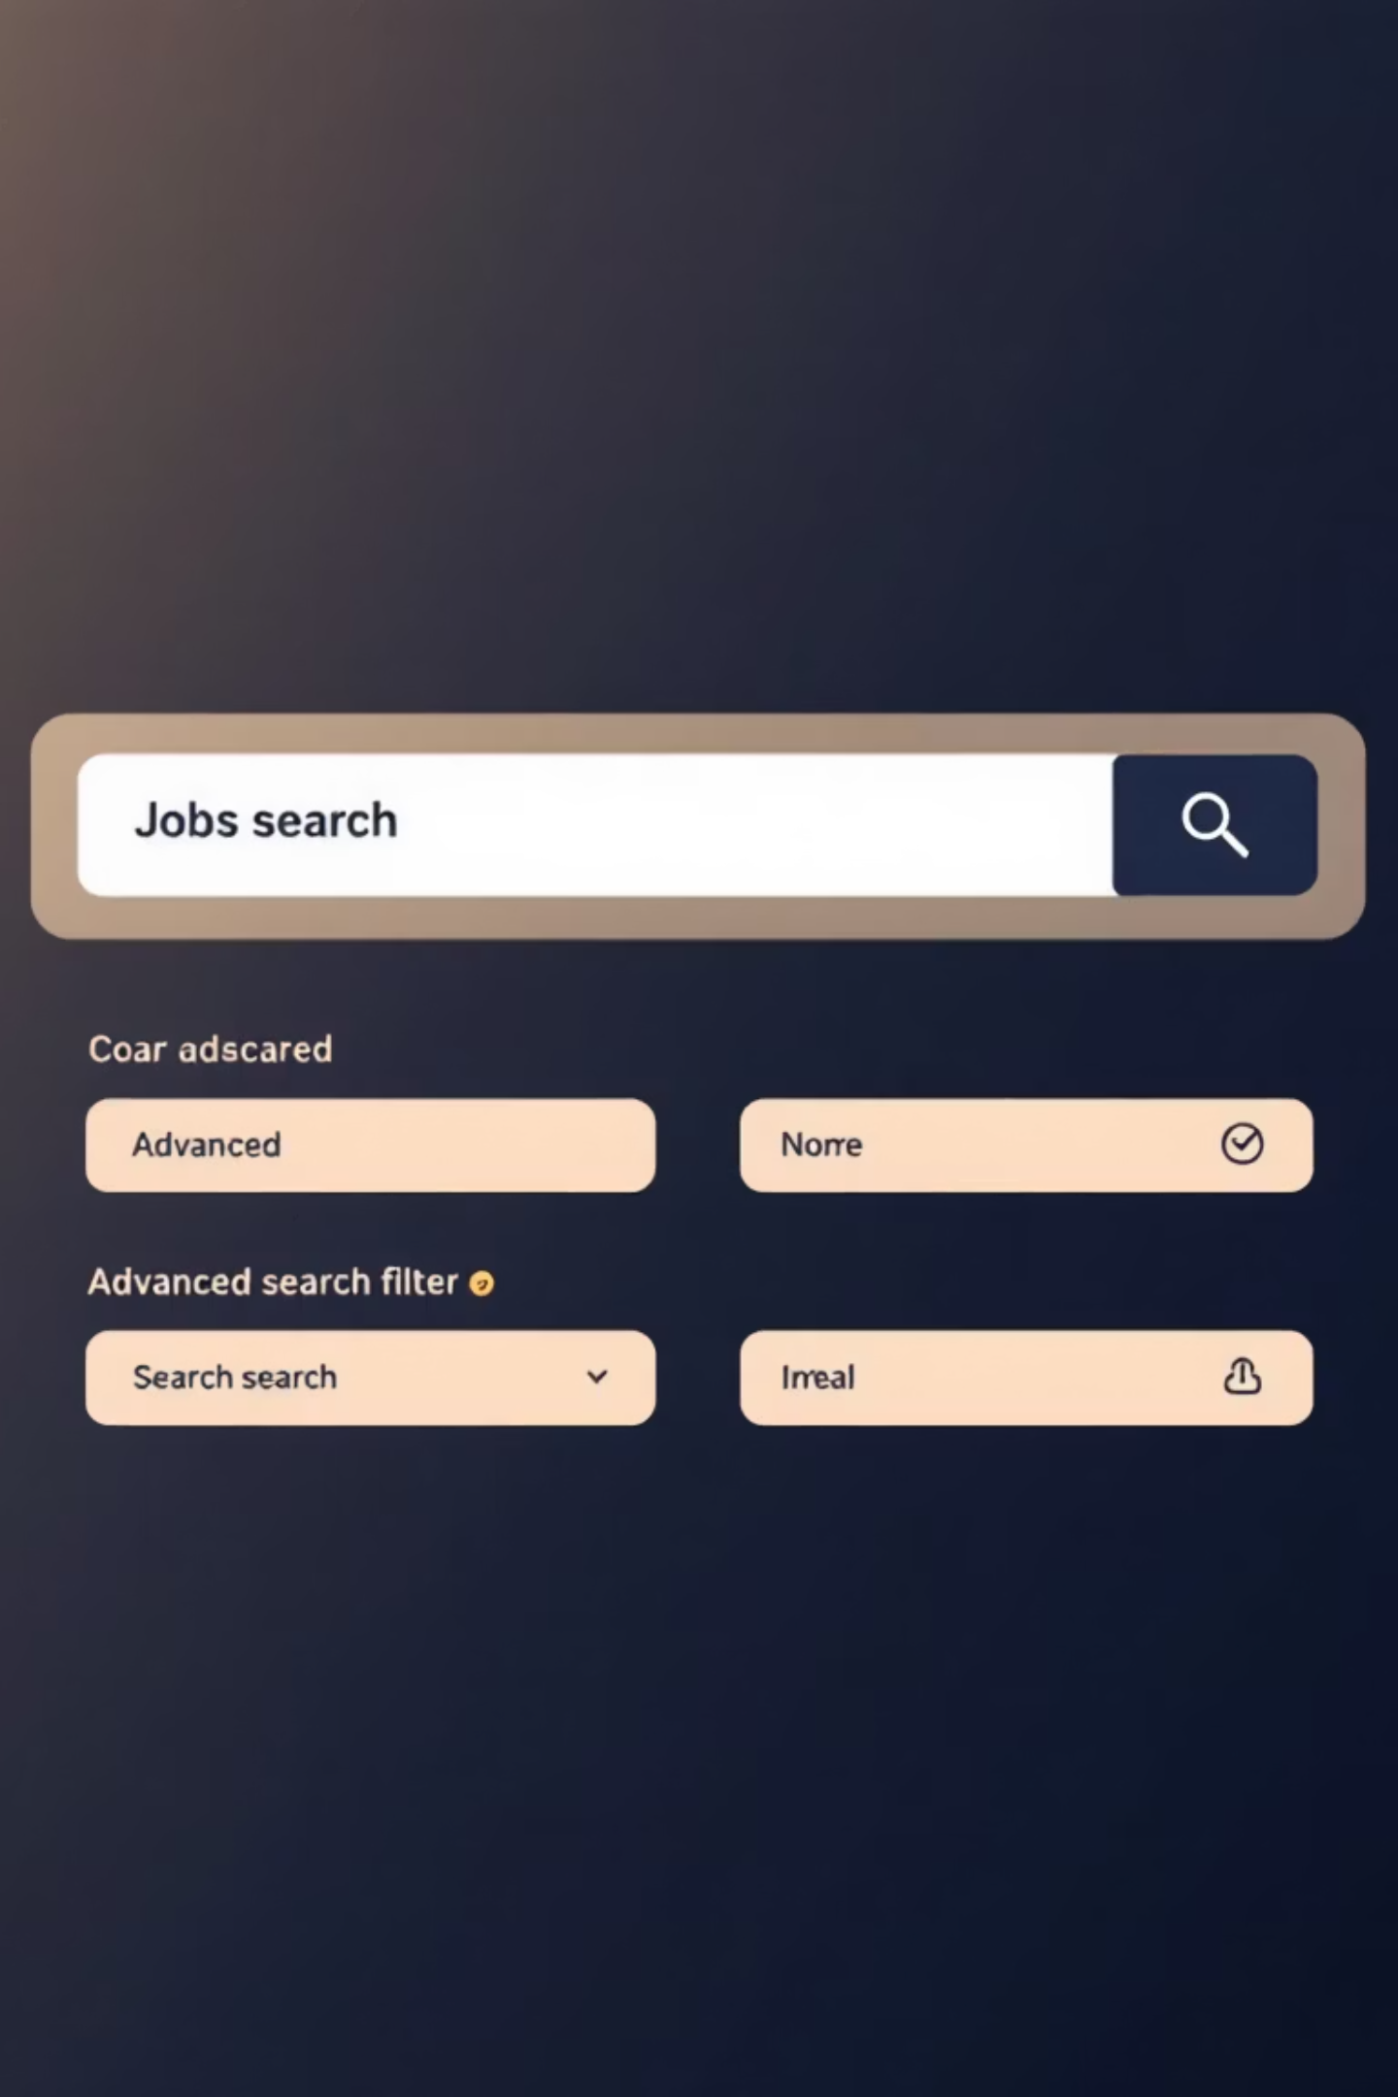
Empowering Job Seekers: Key Features
Our portal is designed with a suite of features to give job seekers a distinct advantage in their search:
Profile Creation
Seamless user registration, comprehensive profile building, and easy resume upload capabilities.
Advanced Search
Robust filters allowing precise job searches by location, industry, job role, salary range, and experience level.
Personalized Alerts
Automated job alerts and notifications, ensuring users are informed of new opportunities matching their saved criteria.
Direct Communication
Integrated messaging tools for direct, confidential communication with prospective employers.

Slide 5
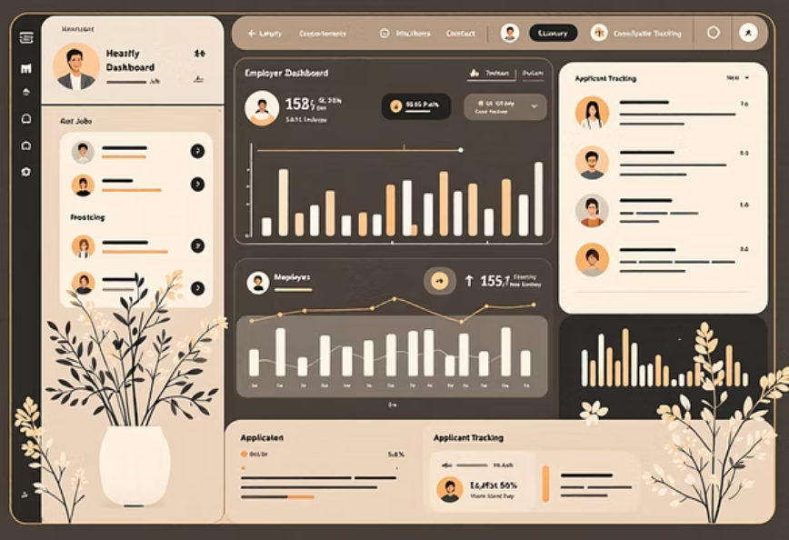
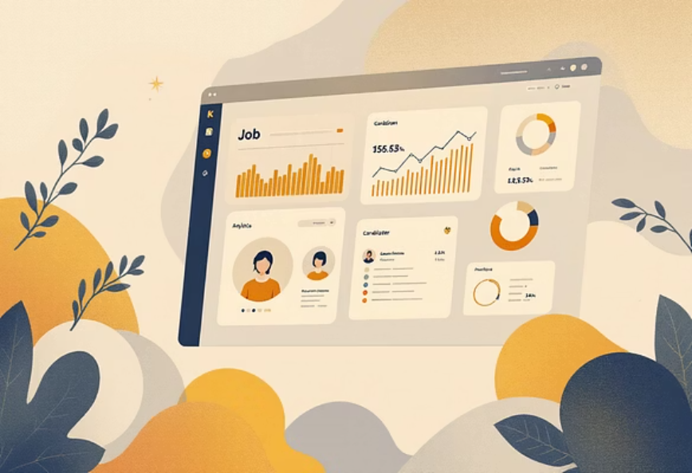
Streamlining Employer Recruitment: Essential Features
For employers, the portal provides powerful tools to manage their hiring process efficiently and effectively:
Company Profiles
Job Management
Dedicated sections for employer registration and the creation of compelling company profiles to attract top talent.
An intuitive dashboard for posting, editing, and managing job listings with ease.
Candidate Sourcing
Interview & Messaging
Access to a searchable resume database and tools to actively seek out suitable candidates.
Integrated features for scheduling interviews and facilitating seamless communication throughout the hiring cycle.

Slide 6






Admin Oversight: Ensuring Portal Integrity
The administration panel is crucial for maintaining the quality, security, and smooth operation of the job portal. Our robust admin tools enable comprehensive management.
User Sign-up
UX Feedback
Verification
Moderation
Monitoring
User account verification and moderation ensure a legitimate and safe community for all users.
Rigorous job posting approvals and quality control procedures maintain the relevance and accuracy of listings.
Advanced reporting tools provide insights into job applications, user activity, and critical feedback metrics for continuous improvement.

Slide 7

The Technology Powering Our Portal
Our online job portal is engineered with cutting-edge technology to deliver a high-performance, scalable, and secure experience for all users.
Frontend & Backend: Built using ASP.NET and C# for a robust and reliable architecture, providing both powerful server-side logic and a dynamic user interface.
Database Management: SQL Server serves as our secure and efficient database solution, ensuring data integrity and rapid retrieval of job listings and candidate profiles.
Accessibility: A responsive design guarantees optimal viewing and interaction across all devices, from desktop computers to mobile smartphones, ensuring maximum reach and usability.

Slide 8


Mutual Benefits: A Win-Win for All
The online job portal delivers significant advantages to both job seekers and employers, transforming traditional recruitment into a more efficient, effective, and economical process.
Before
1
Slow, manual matching processes; limited reach.
2
After
Faster, targeted job matching; broader visibility.
Efficiency: Achieve faster and more targeted job matching, saving valuable time and effort for both parties.
Visibility: Employers gain increased visibility, enhancing their ability to find and attract top-tier talent.
Cost Savings: Benefit from a more cost-effective recruitment process compared to traditional, often expensive, methods.
Enhanced Communication: Streamlined communication tools simplify the entire hiring journey, from initial contact to offer.

Slide 9

Impact & Success: Transforming Lives
Our online job portal isn't just a platform; it's a catalyst for real-world change, connecting individuals with opportunities and companies with the talent they need to thrive.
40%
2 Weeks
10K+
Hiring Time Reduced
Job Found
Active Users
Job seeker Y successfully secured a new role within just two weeks, thanks to the personalized job alerts and streamlined application process.
The portal boasts over 10,000 active users monthly, demonstrating its growing reach and effectiveness in the job market.
Company X reported a significant 40% reduction in their average hiring time after integrating our portal into their recruitment strategy.

Slide 10

Empowering Careers Through Technology
Online job portals are revolutionizing the landscape of recruitment, ushering in a new era of efficiency, connectivity, and opportunity.
They create invaluable connections, fostering a win-win scenario where talent meets its perfect match, and businesses flourish with the right people.
Join us in building the future of work — faster, smarter, fairer.

